Slide 1


ADVENTURE WORKS SALES ANALYSIS
Presenting by: Sneha Priya K
Dipayan
Ayaj
Sandeep
Farhan
Nikhil
Ramesh

Slide 2
Final Project Presentation
Week 1:
Excel Analysis
01
Week 2:
SQL & Tableau Analysis
02
Week 3:
Power BI Analysis
03

Slide 3
PROJECT OVERVIEW
The project was completed over three weeks using the same AdventureWorks dataset, with a separate analytical deliverable for each week.

Slide 4
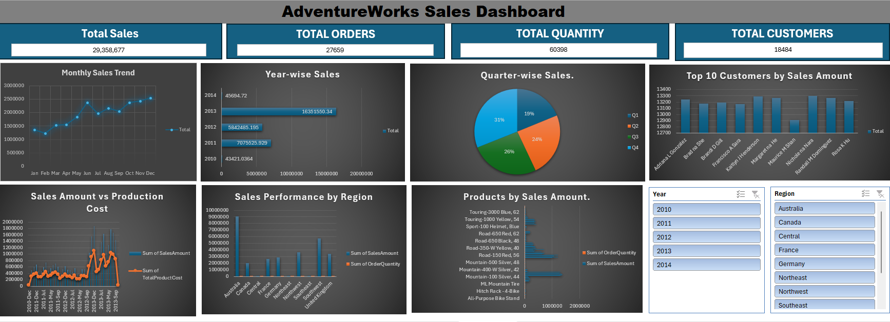
WEEK 1
Excel
Data analysis
KPI calculations
Sales analysis
Dashboard creation
Key Analysis
Overall sales performance
Monthly sales trend
Year-wise sales
Quarter-wise sales
Regional performance
Product performance
Customer analysis

Slide 5
Excel Findings
1. Sales Trend
Sales increased significantly over the analysed years, with 2013 contributing the highest sales.
2. Product Performance
Mountain-200 and Road-150 products were among the major contributors to overall sales.
3. Regional Performance
Australia recorded the highest regional sales contribution, followed by Southwest.
4. Cost Analysis
The Sales Amount vs Production Cost analysis helped compare revenue generated against the
cost of production.

Slide 6
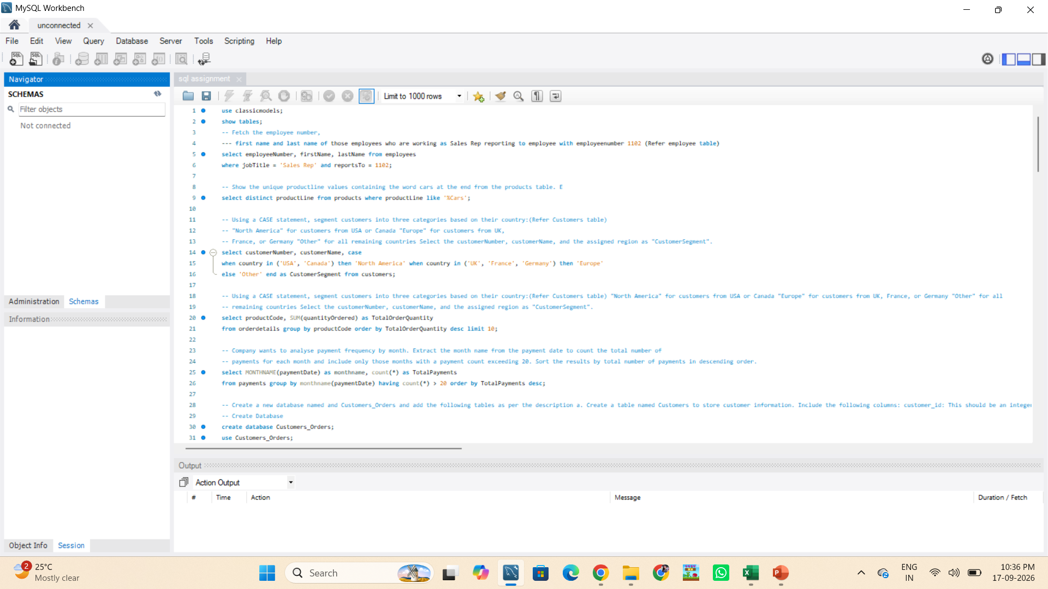
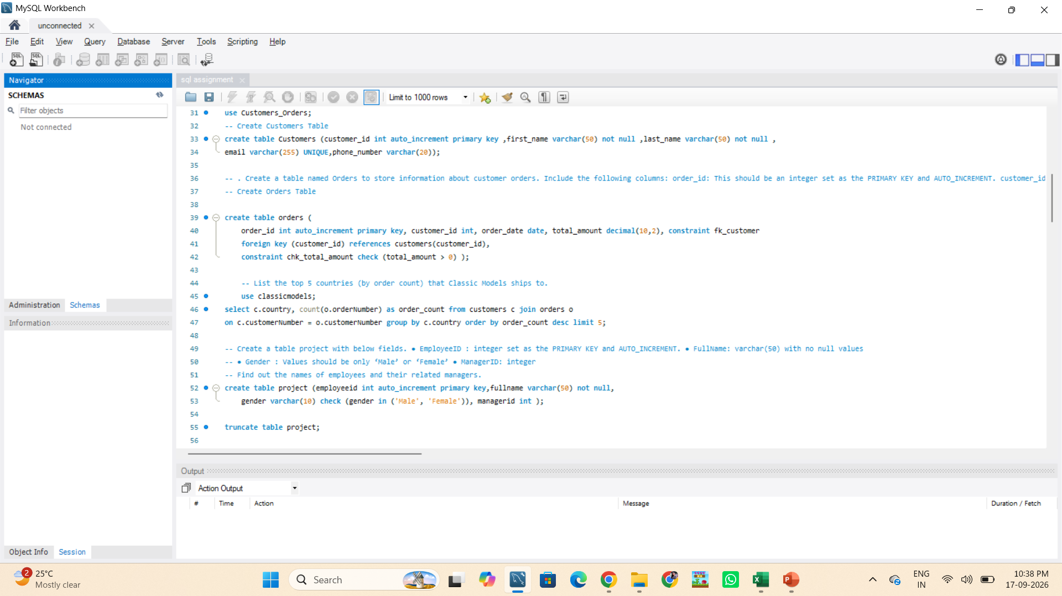
WEEK 2
SQL + Tableau
SQL-based analysis
Business queries
Data visualization
Tableau dashboard
SQL Analysis Focus
Aggregation
Filtering
GROUP BY
JOINs
Ranking
Business KPIs

Slide 7
SQL Finding
Data filtering using WHERE
Aggregation using SUM() and COUNT()
Grouping using GROUP BY
Filtering aggregated results using HAVING
Sorting using ORDER BY
Joining related tables
Analysing customers, products, sales and regions

Slide 8
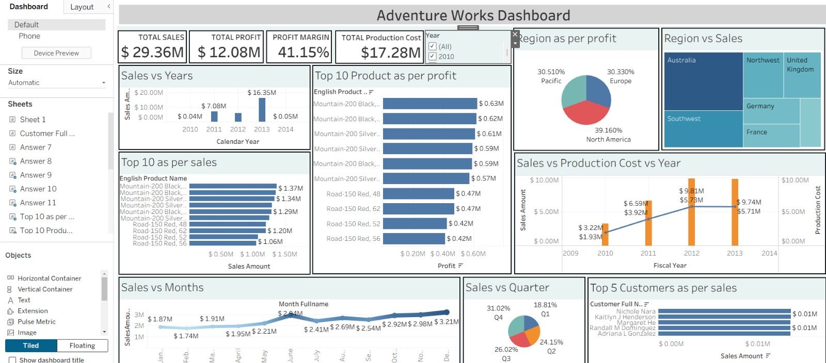
WEEK 2
SQL + Tableau
SQL-based analysis
Business queries
Data visualization
Tableau dashboard
SQL Analysis Focus
Aggregation
Filtering
GROUP BY
JOINs
Ranking
Business KPIs

Slide 9
Tableau Findings
1. Sales & Profit
The dashboard shows total sales of approximately $29.36M and total profit of approximately $12.08M, with a profit margin of 41.15%.
2. Product Performance
Mountain-200 and Road-150 products appear among the leading products based on sales and profit.
3. Regional Performance
Regional analysis shows differences in sales and profit contribution across geographic markets.
4. Time Analysis
Sales increased substantially across the analysed years, with 2013 showing the highest sales level.

Slide 10
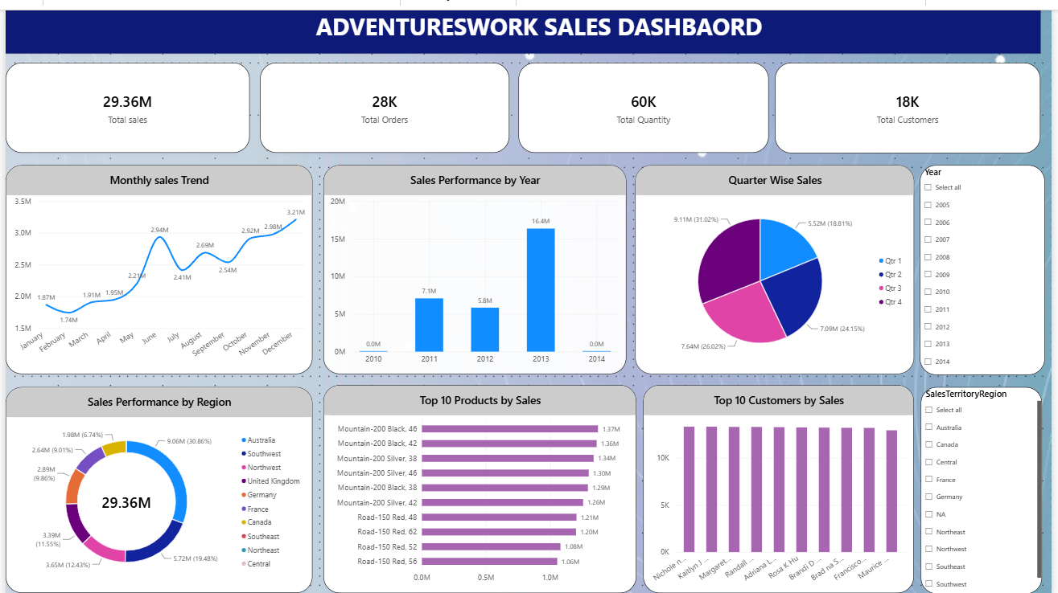
WEEK 3
Power BI Sales Analysis
29.36M Total Sales
28K Total Orders
60K Total Quantity
18K Total Customers
Monthly Sales Trend
Sales Performance by Year
Quarter Wise Sales
Sales Performance by Region
Top 10 Products
Top 10 Customers
Year filter
Region filter

Slide 11
Power BI findings
1. Year-wise Sales
2013 recorded the highest sales at approximately 16.35M, compared with 7.08M in 2011 and 5.84M in 2012.
2. Quarterly Sales
Q4 contributed the highest share of quarterly sales at approximately 31%, followed by Q3 at 26%.
3. Monthly Sales
December recorded the highest monthly sales at approximately 3.21M, while February recorded the lowest at approximately 1.74M.
4. Regional Sales
Australia was the largest regional contributor with approximately 9.06M, followed by Southwest with approximately 5.72M.
5. Top Products
Mountain-200 variants and Road-150 variants were among the highest-selling products.

Slide 12
Key Achievements
Gained practical experience working with a real-world AdventureWorks sales dataset.
Learned to analyse sales data using Excel, SQL, Tableau and Power BI.
Developed skills in data cleaning, filtering, aggregation and analysis.
Created interactive dashboards to communicate business information clearly.
Analysed sales trends, product performance, customer behaviour and regional performance.
Learned how to convert raw data into meaningful business insights.
Improved my understanding of KPIs, data visualisation and business reporting.
Developed the ability to use data analysis to support business decision-making.

Slide 13
Business Recommendations
01 — Product Strategy
Prioritise inventory and marketing for high-performing products such as Mountain-200 and Road-150.
02 — Regional Strategy
Strengthen successful markets and investigate opportunities in lower-performing regions.
03 — Seasonal Planning
Prepare inventory and resources ahead of high-sales periods, particularly Q4 and December.
04 — Profitability Management
Evaluate products using both sales and profit rather than sales alone.
05 — Customer Retention
Use customer-level analysis to identify valuable customers and develop targeted retention strategies.

Slide 14
THANK YOU

